Slide 1
Provenance-Based Security in Secure Dependable Systems
Dr. Ragib Hasan
Professor, Computer Science
University of Alabama at Birmingham
ragib@uab.edu

Slide 2
Presenter Information
Dr. Ragib Hasan
Professor, Computer Science
University of Alabama at Birmingham
Birmingham, AL, USA
Director, UAB Center for Cyber Security
Director, UAB SECRETLab
Contact: ragib@uab.edu

Slide 3
Security: From Real Life to Dependable Systems
Security is an integral aspect of Dependable Systems
The Dependability property is reliant on the system being reliable, secure, and trustworthy.
However, our traditional security mechanisms are very rigid, and cannot model our real-life concepts of trust establishment and security

Slide 4
There is a big disconnect between how we establish trust in real life vs. in the digital systems
In real life, trust is not dependent on single factors.
We use history, prior acquaintance or interactions, mutual friends, how long we know someone, and many other factors to decide whether we can trust someone
For example, if we meet someone today and interact with them, we use the history or “memory” of this interaction when we meet them again in the future
Humans tend to value and trust long term acquaintances more than recent acquaintances

Slide 5
Security in Digital systems is often dependent on single factors
In the digital world, we seldom take such quality of factors into consideration when making security decisions
Authentication or access control are almost always all-or-nothing
Possession or presentation of a valid authentication factor gives full access to a system, regardless of the age of the factor or how the factor was obtained
Security decisions are binary – and we use many different mechanisms to authenticate (passwords/tokens/biometrics), thus complicating our system design

Slide 6
Why is this happening?
Real life human model of security is based on multiple factors
We value the “memory” of our interactions with people
If we never had interactions with someone before, then even if they present any valid credential to be our long term friend, we don’t trust them
“memories” or interactions are also used in a transitive way – if someone has had interactions with someone we know, we often have some trust on them
Time is a major factor in our real life trust – we trust people we have interacted with for a long time more than people we just met
Unfortunately, our digital systems don’t reflect such real-life trust schemes

Slide 7
How do we merge our real life trust with security concepts in digital systems?
In order to bring our digital systems closer to our real-life concepts of trust and security, we must incorporate past interactions as a fundamental building block of security, along with the consideration of time as an influencing factor
Our trust decision should depend on past human-to-system or system-to-system interactions, and all security operations such as authentication and access control should be based on this
In other words, Provenance of past interactions can be the unifying fundamental building block of all security, and can bring our real life security concepts to digital systems

Slide 8
What is Provenance
and why is it so important in real life?

Slide 9
Real world Example of the Use of Provenance
Let’s play a game
Real, worth $101.8 million
Fake, listed at eBay, worth nothing
Can you spot the fake Picasso?

Slide 10
So, how do art buyers authenticate art?
Among other things, they look at provenance records
Provenance: from Latin provenire ‘come from’, defined as
“(i) the fact of coming from some particular source or quarter; origin, derivation.
(ii) the history or pedigree of a work of art, manuscript, rare book, etc.; a record of the ultimate derivation and passage of an item through its various owners” (Oxford English Dictionary)
In other words, who owned it, what was done to it, how was it transferred …
Widely used in arts, archives, and archeology, called the Fundamental Principle of Archival.
L'artiste et son modèle (1928), at Museum of Modern Art
http://moma.org/collection/provenance/items/644.67.html

Slide 11
Using Provenance for Security
Provenance has been used for security in many different ways
Data Provenance gives information about the origin and derivation history of data
Source provenance allows verifying the trustworthiness of objects using their history
Location provenance allows verifying someone’s or something’s location history
Extending the idea further, interaction provenance can record the interaction between two users, a user and a system, or two systems
The chronological collection of such interaction provenance can be used for any security operation, ranging from authentication and access control, to quantified trust

Slide 12
Interaction Provenance
Interaction provenance is the chronologically ordered set of Past events and actions between user and other entities
Insight from real life: Social authentication driven model – people recognize each other based on previous interactions
Insight from causality: All forms of authentication are dependent on some past event
Account creation, Registration, etc.

Slide 13
Challenges with Interaction Provenance
How do we ensure the integrity of provenance in a decentralized manner?
How do we ensure the confidentiality of provenance (i.e., selectively allow certain interactions to be revealed while keeping others private)?
Are interactions the same for both parties?
Implementation – where would the interaction provenance information be stored?

Slide 14
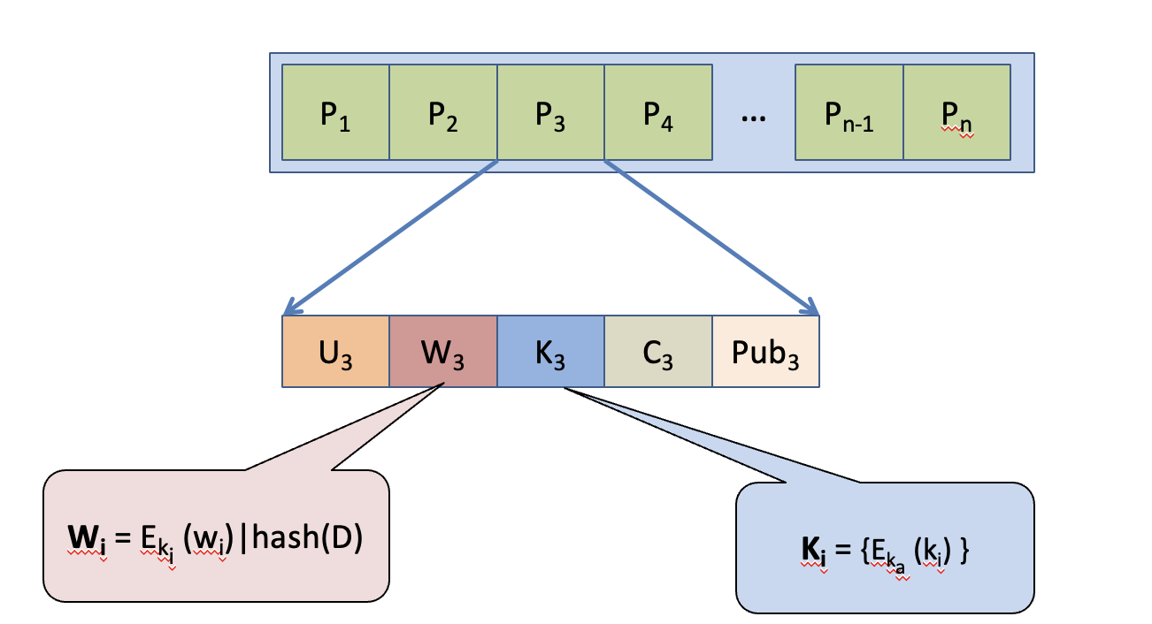
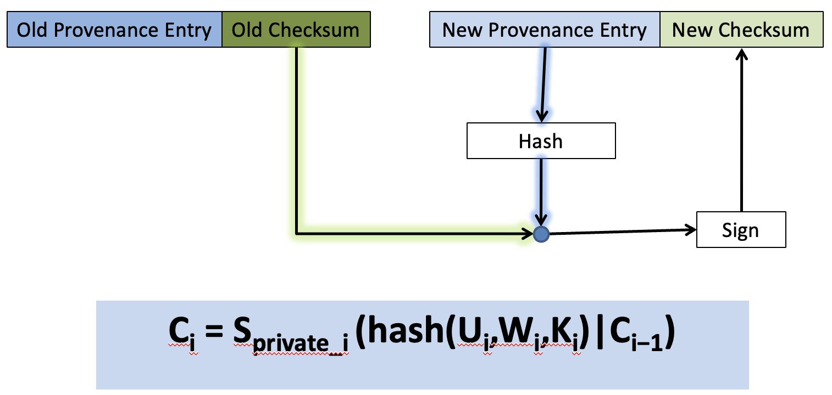
Solutions for integrity and confidentiality
Individual Provenance entries can be protected by digital signatures
The integrity of the chain chronology can be protected via a signed hash chain scheme
Privacy of individual provenance entries can be protected using a bit commitment scheme
Preventing history forgery with secure provenance R Hasan, R Sion, M Winslett ACM Transactions on Storage (TOS) 5 (4), 1-43

Slide 15
Security Use Cases for
Interaction Provenance

Slide 16
Interaction Provenance Use Case 1: Unified Authentication Factors
Interaction provenance can be used to unify authentication factors
Such Interaction provenance-based authentication can mimic our real life authentication and trust models, and result in flexible, more expressive security similar to our real life.
Unified authentication factors and fuzzy service access using interaction provenance, R Hasan, R Khan, Computers & Security 67, 211-231

Slide 17
Factors of Authentication
Currently used authentication factors include:
Knowledge: What does the user know?
Password, Shared knowledge
Possession: What does the user have?
Token, Certificate
Biometrics: What bodily attributes the user has?
Fingerprint, Voice, Iris, Face
Contextual Information: Any additional proof?
Location, Recommendation

Slide 18
Issues in Traditional Authentication
Service Complexities
Multi-factor reduces usability
Service composition requires complex integration
Cross-platform provision requires separate provisioning,
Anonymity is not inherent,
User-centricity not implicitly supported
Usage Vulnerabilities
No timeline of credential
Identity theft
Fixed shared secret model
Binary access/deny output
Re-authentication reduces usability
Rigidity and inflexibility of policies

Slide 19
Specific Issues
Increased security → Reduced usability
Password: Easy → Vulnerable, Strong → Difficult to remember
Certificates/Tokens → Reduced portability
Biometrics → Permanently unusable if forged
Contextual information → No absolute dependability
Cross-platform authentication is still a challenge
All authentication factors have different representations
Conventional authentication → Credential possession
Access control/Authorization → Separately maintained

Slide 20
Goals for the ideal authentication scheme
An authentication model which ...
is secure
is easy to use / User-centric
has no additional hardware requirements
is backward compatible
removes service complexities
reduces usage vulnerabilities
SECuRE and Trustworthy computing Lab
Department of CIS, UAB
http://secret.cis.uab.edu

Slide 21
Hint: Mimic Our Social Authentication Notions
Notion 1: Previous interactions, events, and actions with each other decide if a person recognizes or trusts another person at a given point of time
Notion 2: Humans rely on the quality of authentication in real-life based on the nature and length of previous interactions.

Slide 22
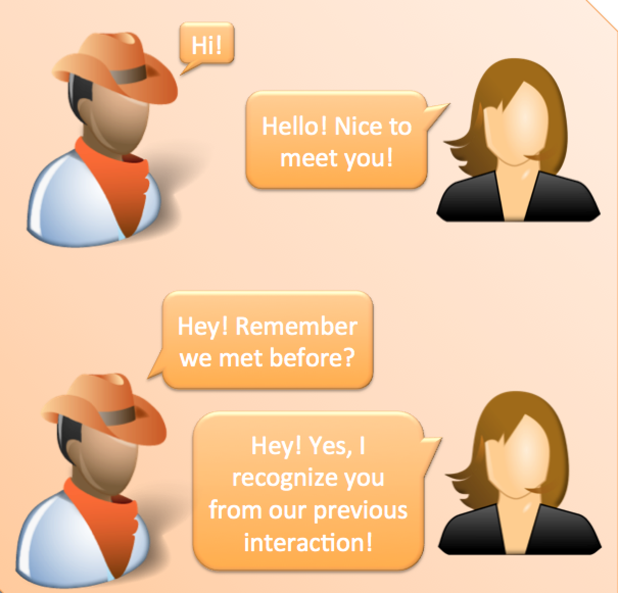
Analogy from Social Authentication in real life

Slide 23
Our Approach: Unification of Authentication Factors using Interaction Provenance
Conventional Authentication
Past events
Present
time
Authentication with Interaction Provenance
Insight: Authentication and Authorization/Access Control decisions are *always* based on past events (did the user register, does the system know the user (from a past event)?

Slide 24
Interaction Provenance for Authentication
User actions are a string of events on a single timeline
Represent past events in the form of interactions
Use sub-set of interactions (k out of n) to authenticate users
Use generic model to represent interactions
Interaction [UserID, ProviderID, EventType [Key:Value, ..]]

Slide 25
Application of interactions in authentication

Slide 26
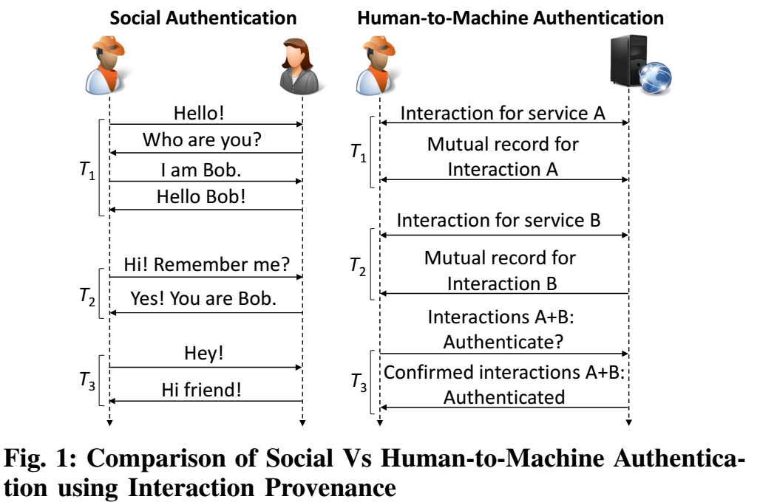
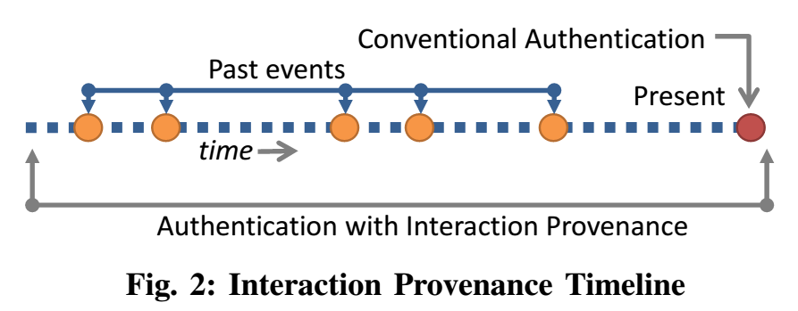

Slide 27
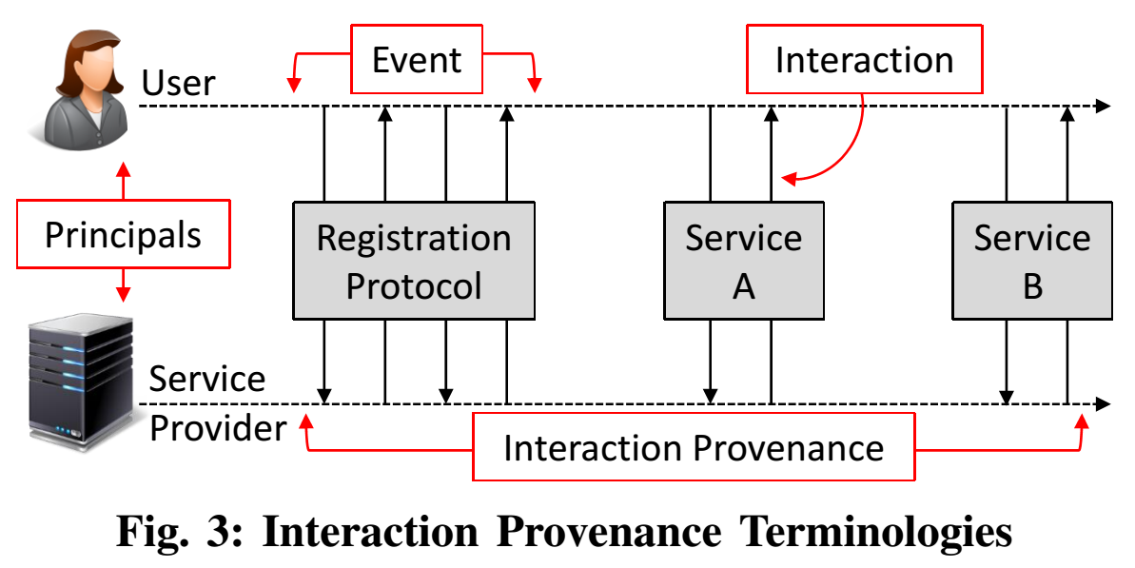
Concept | Interaction Provenance

Slide 28
Interaction Provenance Authentication (Overview)
Interaction
Request service
Provenance
Maintain provenance
Authentication Factor
Exchange subset of provenance chain
Respond service
Mutual recording
Insert interaction
Secure & tamper-proof
Validate and authenticate

Slide 29
Interaction Provenance Unified Authentication Factor
Example 1: Username/Password registration event

Slide 30
Interaction Provenance Unified Authentication Factor
Example 2: Certificate registration event

Slide 31
Interaction Provenance Unified Authentication Factor
Example 3: File upload event to a file server

Slide 32
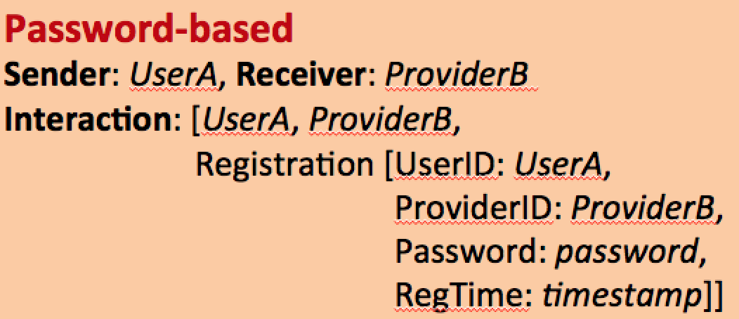
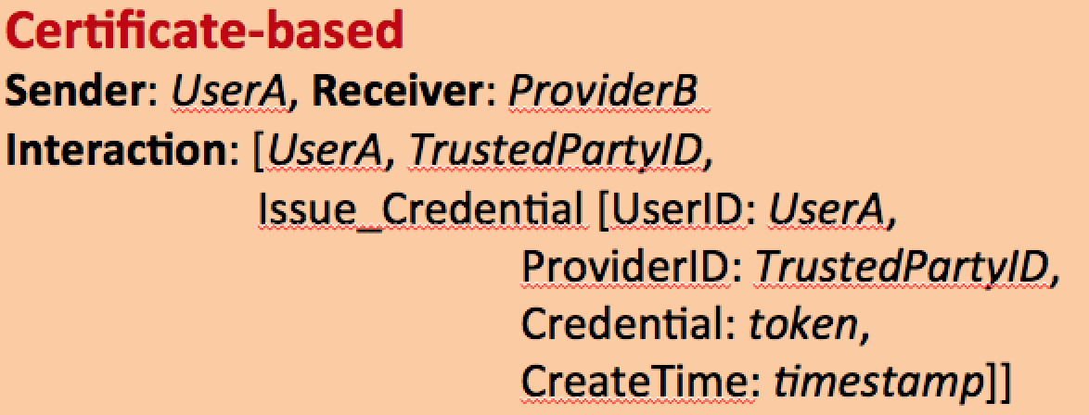
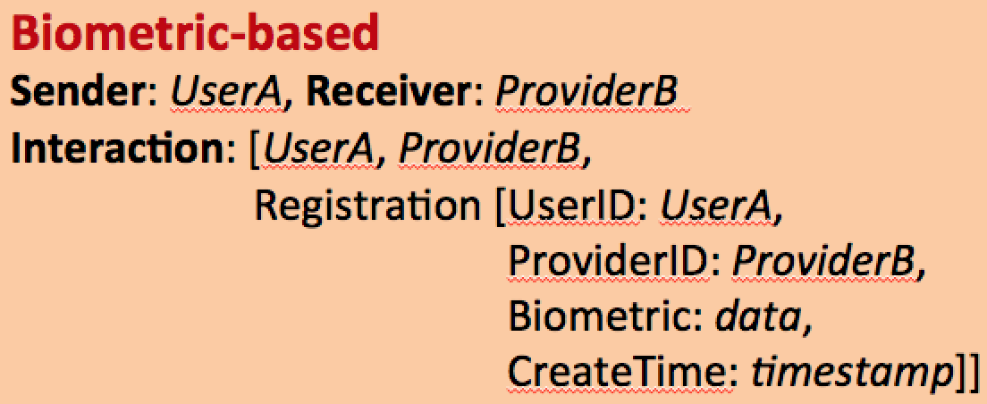
Advantages of Interaction Provenance
Unification of Authentication Factors
Interaction Provenance model can be used to unify all types of current authentication factors

Slide 33
Advantages of Interaction Provenance
Using Time as a Qualifier in Authentication
Interaction provenance can be used to enforce authentication mechanisms based on a string of past events, in contrary to only presenting credentials at the present moment. This allows an improved level of security for the domain of service oriented computing.

Slide 34
Advantages of Interaction Provenance
Newer methods of authentication and mutual authentication
The model allows newer methods or factors of authentication, such as, knowledge belonging to group interactions. This also introduces increased flexibility in authentication and brings the authentication process closer to real life trust establishment.
Interaction provenance can allow mutual authentication of users and providers, where both of which should present a previous record of interaction.

Slide 35
Advantages of Interaction Provenance
Anonymous Authentication
We can utilize interactions to allow anonymous authentications by creating an authentication event the first time, and validating the provenance in the subsequent occasions.

Slide 36
Advantages of Interaction Provenance
Flexible, Richer, and Simpler Semantics/Policies
Extending the idea of interaction provenance to other security problems introduces significant benefits. Authorization and access control can be defined using richer and simpler semantics, which will allow writing complex and innovative security policies based on past interactions.
We can also authenticate ourselves to people who we never met before, by providing interaction provenance with someone they know and trust

Slide 37
Other Advantages
Unified service interaction model
Supports legacy authentication factors
Timeline authentication
User centricity
Anonymous authentication
Privacy of non-linkability
Easier service composition architectures
Evolving shared secret

Slide 38
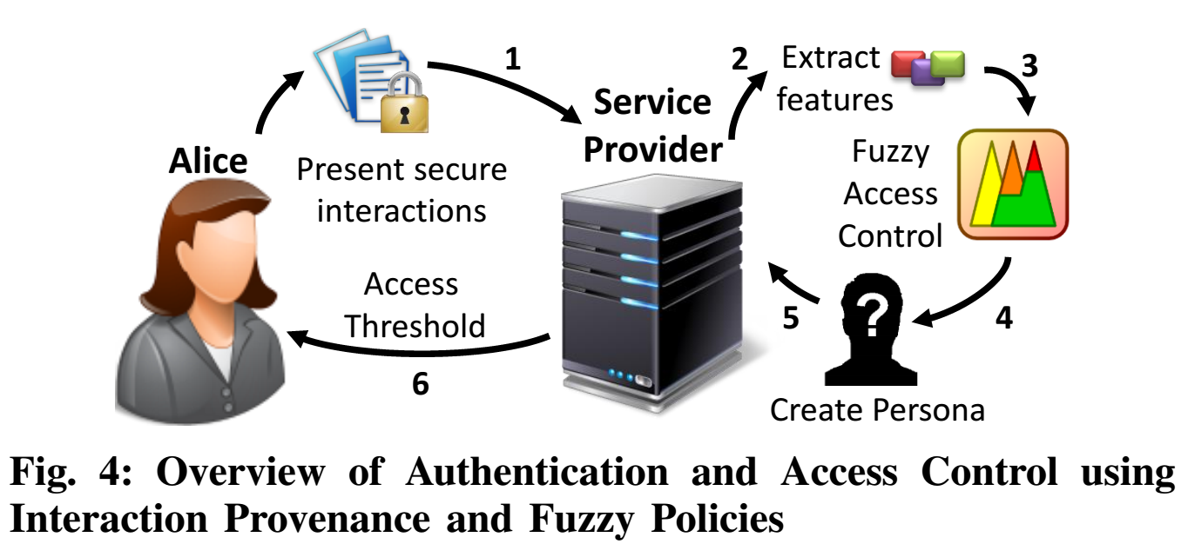
Fuzzy Authentication Interaction Provenance
SECuRE and Trustworthy computing Lab
Department of CIS, UAB
http://secret.cis.uab.edu

Slide 39
Fuzzification of Interactions
Input Vectors
Event
Device
Output Vector
Persona
Epoch
The Persona of a list of interactions is the value obtained using an aggregation function using Device, Epoch, and Device inputs for a given fuzzifier and defuzzifier.
SECuRE and Trustworthy computing Lab
Department of CIS, UAB
http://secret.cis.uab.edu

Slide 40
Fuzzy Ranges
Event (V_{Ev})
Epoch (V_{Ep})
Device (V_{Dv})
Persona (V_{P})
Very Low: 0.00 – 0.30
Low: 0.15 – 0.50
Medium: 0.30 – 0.70
High: 0.50 – 0.85
Very High: o.70 – 1.00
SECuRE and Trustworthy computing Lab
Department of CIS, UAB
http://secret.cis.uab.edu

Slide 41
Fuzzy Control Logic (why is it awesome?) Examples of Linguistic Policies
If Event is VeryLow and Epoch is VeryLow and Device is VeryLow then Persona is Null
If Event is VeryLow and Epoch is VeryLow and Device is VeryLow then Persona is Null
SECuRE and Trustworthy computing Lab
Department of CIS, UAB
http://secret.cis.uab.edu

Slide 42
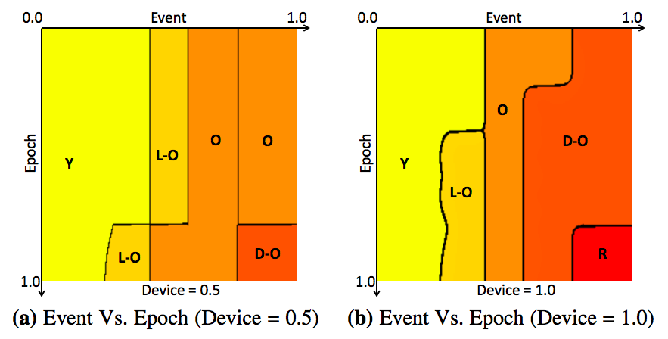
Fuzzy Control Logic (why is it even more awesome?) Visualization using Contour Maps

Slide 43
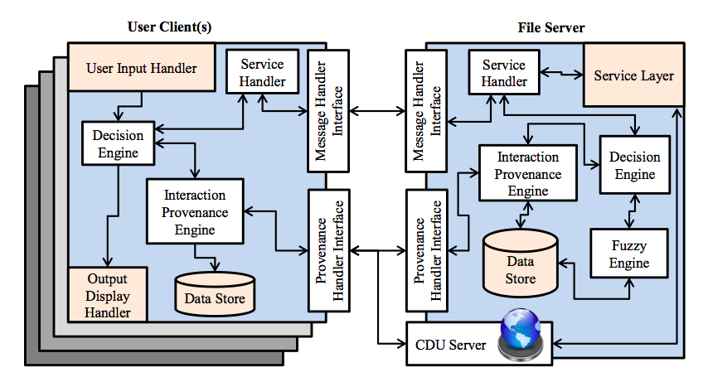
Implementation Interaction Provenance Aware File Server

Slide 44
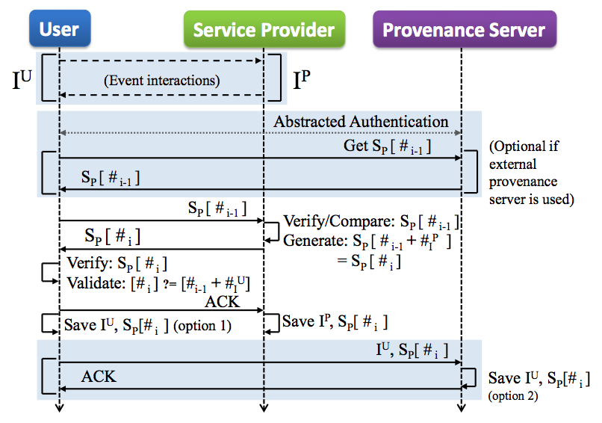
Interaction Provenance Recording Protocol

Slide 45
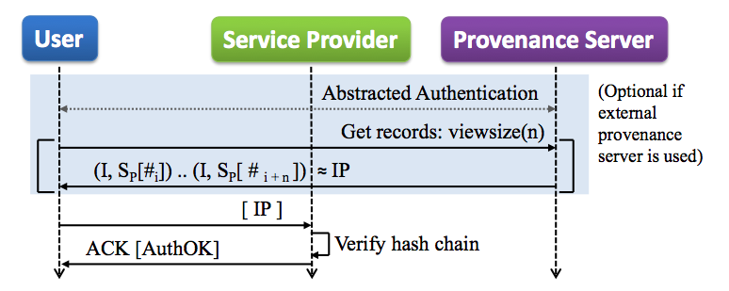
Interaction Provenance Authentication Protocol

Slide 46
Interaction provenance Use Case 2: Securing Healthcare devices
Interaction provenance can also be useful for securing dependable healthcare devices
Reliable function of Healthcare devices depend on trustworthy configurations
The vulnerabilities in short range and long range communication protocols can allow an attacker to compromise a smart healthcare device and change the settings and configurations, which in turn can be fatal for the patient
In such a scenario, interaction provenance can be useful to provide trust on configurations

Slide 47
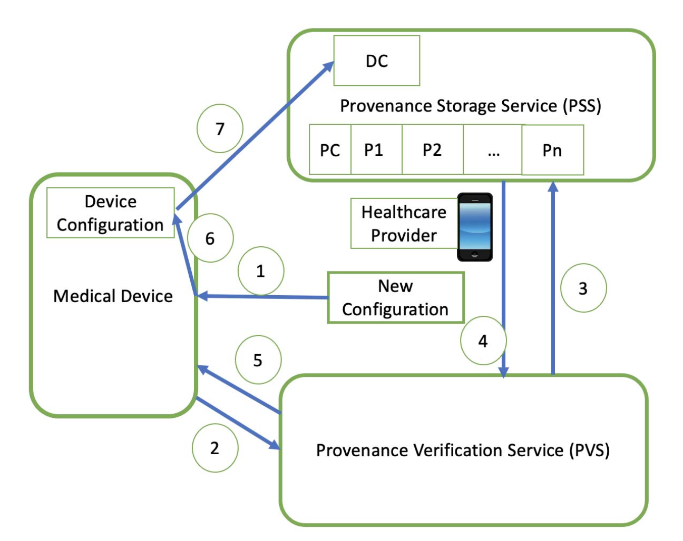
Interaction provenance for Securing Healthcare devices
In a provenance-based security model for medical devices, each configuration update also carries a provenance chain showing the entire history of the configuration (including the originator, the modifier, the path)
When applying the new configuration, in addition to other security mechanisms, provenance can be validated to determine the trustworthiness of the configuration
This prevents malicious users with a valid but compromised credential from applying a forged configuration.
Towards Strengthening the Security of Healthcare Devices using Secure Configuration Provenance, R Hasan, 2022 IEEE International Conference on Digital Health (ICDH), 228-233

Slide 48
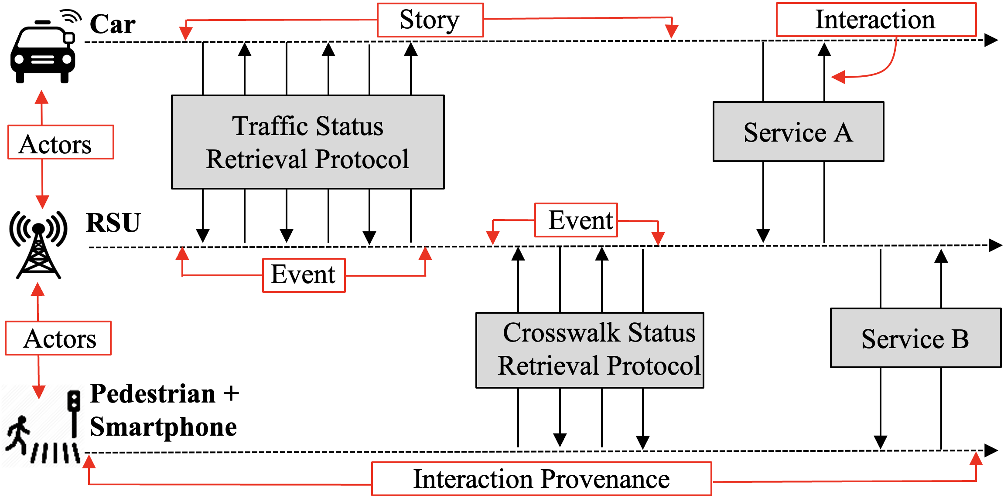
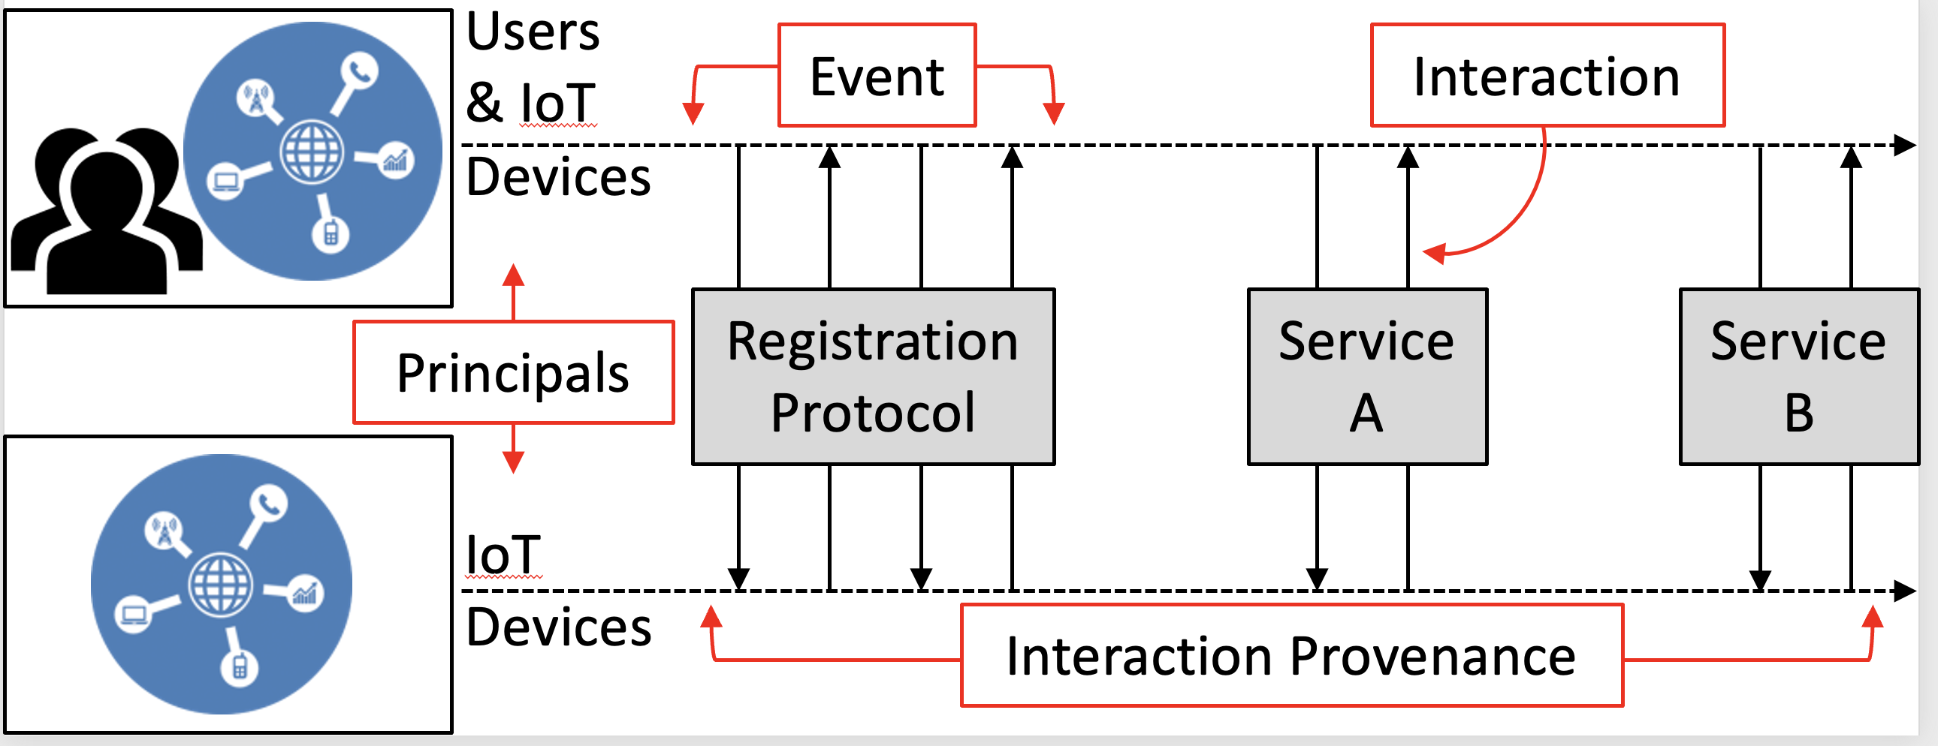
Other Applications
Interaction provenance can also be used to create a trust management framework for connected autonomous vehicles as well as for IoT devices
A Trust Management Framework for Connected Autonomous Vehicles Using Interaction Provenance, MA Hoque, R Hasan ICC 2022-IEEE International Conference on Communications, 2236-2241

Slide 49
Key Takeway
Use of interaction provenance can bring our real life trust models to dependable systems
Provenance as a fundamental building block of security brings many benefits, including unification of different schemes, consideration of time and other qualifiers for authentication and access control factors, and anonymous authentication
Use of the past history or provenance strengthens security by reducing the impact from stolen credentials

Slide 50
Acknowledgements
Joint work with Rasib Khan, Raiful Hasan, and MA Haque
Funded by the National Science Foundation and the Department of Homeland Security

Slide 51
Questions?
Contact: ragib@uab.edu

